Slide 1
Resolvers & Upload & Exceptions & Internationalization & Tiles
Harmonizing Diversity

Slide 2
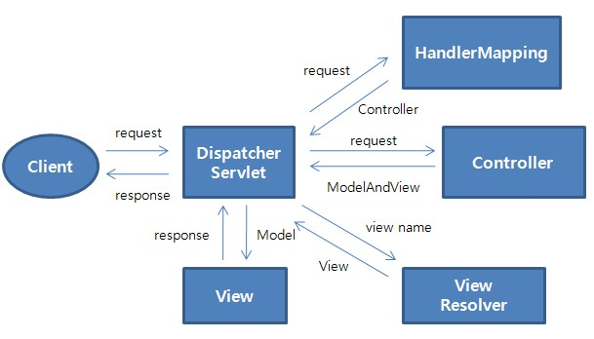
Spring MVC Flow

Slide 3
Spring MVC View Resolvers
Flexible View Resolving Mechanism
Resolve logical String-based view names to View types.
Many out-of-the-box implementations[examples]:
UrlBasedViewResolver-This directly resolves a view name to a URL without any explicit mapping. The view names can be the URL themselves or a prefix or suffix can be added to get the URL from the view name.
InternalResourceViewResolver-This is a subclass of
UrlBasedViewResolver. Out-of-the-box support for JSP
FreeMarkerViewResolver-This is a subclass of UrlBasedViewResolver that supports FreeMarkerView and its subclasses.
VelocityViewResolver-This is a subclass of UrlBasedViewResolver that supports VelocityView and its subclasses.
ContentNegotiatingViewResolver-This is an implementation of a view resolver based on the request file name or Accept header – mime-type. This class delegates view resolution to other view resolvers that are configured.

Slide 4
Multiple View Resolvers Configuration
<!-- lower order value has a higher priority -->
<bean
class="org.springframework.web.servlet.view.InternalResourceViewResolver">
  <property name="prefix" value="/WEB-INF/views/" />
  <property name="order" value="4" />
</bean>
<bean class="org.thymeleaf.spring4.view.ThymeleafViewResolver">
  <property name="templateEngine" ref="templateEngine" />
  <property name="viewNames" value="*.html" />
  <property name="order" value="3" />
</bean>

Slide 5
Spring MVC Views
Spring has flexible view support through the View Interface class
Out-of-the-box view support for:
  JspView - InternalResourceViewResolver
  JSON - ContentNegotiatingViewResolver **
  XML - ContentNegotiatingViewResolver **
  PDF - ContentNegotiatingViewResolver **
  Excel - ContentNegotiatingViewResolver **
  Tiles - TilesViewResolver
  Velocity - VelocityViewResolver
  FreeMarker - FreeMarkerViewResolver
  Redirect - InternalResourceViewResolver
  Forward - InternalResourceViewResolver
The ContentNegotiatingViewResolver determines which view resolver to use based on file extension. Foo.json.vs.Foo.xml.vs.Foo.pdf…
[or by URL parameter specifying type of output format or accept header]
** “Candidates”
Notes:
issue with the Accept header - impossible to set it in a web browser - in Firefox, it is fixed
Accept: text/html,application/xhtml+xml,application/xml;q=0.9,*/*;q=0.8
For this reason it is common to see the use of a distinct URI for each representation
By default PathExtensionContentNegotiationStrategy is consulted (which uses the URL extension e.g. .xls, .pdf,.json..) , followed by ParameterContentNegotiationStrategy (which uses the request parameter ‘format=xls’ e.g.), followed by HeaderContentNegotiationStrategy (which uses HTTP Accept Headers).

Slide 6
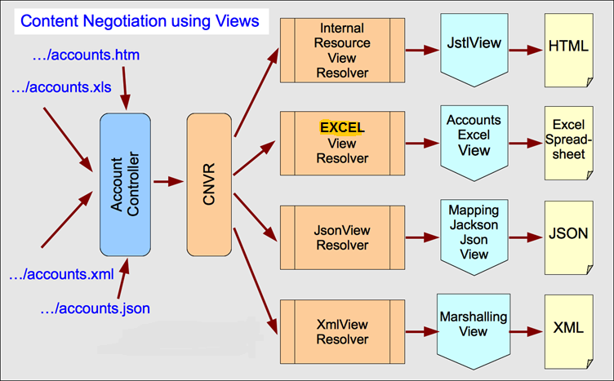
ContentNegotiatingViewResolver
Scenario based on “file extension” in URL:
Single Controller method..multiple views…
CNVR

Slide 7
Resolving Image files for uploading
HTTP multipart request is used by browsers to upload files/data to the server.
Spring good support HTTP multipart request:
  CommonsMultipartResolver
DispatcherServlet XML/Java config:
<bean id="multipartResolver" class="org.springframework.web.multipart.commons.CommonsMultipartResolver">
<property name="maxUploadSize" value="10240000"/>
</bean>
@Bean
public CommonsMultipartResolver multipartResolver() {
  CommonsMultipartResolver resolver = new CommonsMultipartResolver();
  resolver.setDefaultEncoding("utf-8");
  resolver.setMaxUploadSize(10240000);
  return resolver;
}
Notes:
All files are binary even if they should only contain text. application/x-www-form-urlencoded is the standard way to POST a form without attached files. multipart/form-data is the standard way to POST a form with attached file(s). (There are also numerous other encodings, such as application/json
HTTP HEADER _ Content-Type: multipart/form-data;

Slide 8
Resolving Image files for uploading[Cont.]
JSP configuration
<form:form modelAttribute="newProduct" class="form-horizontal" enctype="multipart/form-data">
  <div class="form-group">
    <label class="control-label col-lg-2" for="productImage">
      <spring:message code="addProduct.form.productImage.label" />
    </label>
    <div class="col-lg-10">
      <form:input path="productImage" id="productImage"
      type="file" class="form:input-large" />
    </div>
  </div>
</form:form>
Content-Type: multipart/form-data

Slide 9
Resolving Image files for uploading[Cont.]
Saving image in Controller:
@RequestMapping(method = RequestMethod.POST)
public String processAddNewProductForm(@Valid @ModelAttribute("newProduct") Product newProduct,
BindingResult result, Model model, HttpServletRequest request) {
  MultipartFile productImage = newProduct.getProductImage();
  String rootDirectory = request.getSession().getServletContext().getRealPath("/");
  if (productImage != null && !productImage.isEmpty()) {
    try {
      productImage.transferTo(
      new File(rootDirectory + "resources\\images\\" + newProduct.getProductId() + ".png"));
    } catch (Exception e) {
    throw new RuntimeException("Product Image saving failed", e);
    }
  }
  productService.addProduct(newProduct);
  return "redirect:/products";
}

Slide 10
Main Point
Spring MVC Views and View Resolvers offers a variety of ways to manage the presentation of data.
Life is the expression of the field of all possibilities resulting in a veritable explosion of variety in nature

Slide 11
Handler Exception Resolver
HandlerExceptionResolver interface
    Used to resolve exceptions during Controller mapping & execution
    Two Default implementations [“out of the box”]:
      ResponseStatusExceptionResolver – supports @ResponseStatus
      ExceptionHandlerExceptionResolver – supports @ExceptionHandler
  Exceptions can be handled EITHER individually OR Globally across ALL Controllers with @ControllerAdvice “interceptor”

Slide 12
ResponseStatusExceptionResolver
Marks a method or exception class with the status code and reason that should be returned. “Customizes” exceptions as HTTP status codes
The status code is applied to the HTTP response when the handler method is invoked, or whenever said exception is thrown.
Could reside on Exception OR in @ControllerAdvice

Slide 13
ResponseStatusExceptionResolver (cont.)
Customized Exception:
@ResponseStatus(value = HttpStatus.NOT_FOUND, reason = "No products found under this category.")
public class NoProductsFoundUnderCategoryException extends RuntimeException {
  private String message;
  public NoProductsFoundUnderCategoryException(String message) {
  this.message = message;
  }
}
ProductController.java
@RequestMapping("/products/{category}")
public String getProductsByCategory(Model model, @PathVariable String category) {
  List<Product> products = productService.getProductsByCategory(category);
  if (products == null || products.isEmpty()) {
  throw new NoProductsFoundUnderCategoryException();
  }
  model.addAttribute("products", products);
  return "products";
}

Slide 14
ExceptionHandlerExceptionResolver
Method identified as ExceptionHandler for exception resolution
Could reside in EITHER ProductController OR @ControllerAdvice
  @ExceptionHandler(NoProductsFoundUnderCategoryException.class)
  public ModelAndView handleError(HttpServletRequest req, NoProductsFoundUnderCategoryException exception) {
    ModelAndView mav = new ModelAndView();
    mav.addObject("msg", exception.getMessage());
    mav.addObject("exception", exception);
    mav.addObject("url", req.getRequestURL());
    mav.setViewName("noProductFound");
    return mav;
  }
Exception JSP: noProductFound.jsp
  <div class="jumbotron">
    <div class="container">
      <h1 class="alert alert-danger">{msg}</h1>
    </div>
  </div>

Slide 15
@ControllerAdvice
Indicates the annotated class assists a “Controller”
Works across ALL controllers
It is typically used to define @ExceptionHandler, @InitBinder, and @ModelAttribute methods that apply to all @RequestMapping methods.
Handle all ProductNotFoundException throws in any class:
  @ControllerAdvice
  public class ControllerExceptionHandler {
    @ExceptionHandler(ProductNotFoundException.class)
    public ModelAndView handleError(HttpServletRequest req, ProductNotFoundException exception) {
      ModelAndView mav = new ModelAndView();
      mav.addObject("invalidProductId", exception.getProductId());
      mav.addObject("exception", exception);
      mav.addObject("url", req.getRequestURL() + "?" + req.getQueryString());
      mav.setViewName("productNotFound");
      return mav;
    }
  }

Slide 16
Main Point
A well-defined exception and error handling approach is important for simplifying the development of web applications.
The removal of obstacles is an important aspect of the process of evolution.

Slide 17
Internationalization
i18n – ‘i’+ 18 chars + ‘n’ == internationalization
Support for multiple languages & data format with code rewrite
Examples:
    zh Chinese nl Dutch
    hi Hindi el Greek
    ja Japanese fr French
L10n = ‘I’+10 chars + ‘n’ = localization
Support locale-specific [geographic/region/country] information
    Egypt EG Libya LY China CN
    India IN Taiwan TW
  Mynmar MM Mongolia MN

Slide 18
Java Locale class
Locale(String language)
Locale(String language, String Country)
Locale(String language, String Country, String variant)
Variant is browser specific code [windows, MAC, etc.]
Message are stored in “.properties files indicating Locale
E.g. messages_zh.properties
Optionally messages_zh_CN.properties
Notes:
https://shunchaowang.wordpress.com/2015/04/01/spring-mvc-utf-8-encoding/
Resource Bundle plugin
get into the habit of always specifying an encoding when reading and writing text files….
You shouldn't put the Czech characters in but there encoded form ie \u2349 instead of the actual output.
## Set eclipse preferences - general - add content type for text -
##file association *.properties default encoding UTF-8
<!-- Recognize unicode characters on web page... --> web.xml

Slide 19
Locale Resolvers
Browser’s Accept-Language header
<bean id="localeResolver" class="org.springframework.web.servlet.i18n.AcceptHeaderLocaleResolver">
<property name="defaultLocale" value="en_US"/>
</bean>
Session
  uses a locale attribute in the user's session
<bean id="localeResolver"
class="org.springframework.web.servlet.i18n.SessionLocaleResolver">
<property name="defaultLocale" value="en_US"/>
</bean>
@Bean
public LocaleResolver localeResolver() {
  SessionLocaleResolver resolver = new SessionLocaleResolver();
  resolver.setDefaultLocale(new Locale("en"));
  return resolver;
}
Cookie
  uses a cookie sent back to the user
<bean id="localeResolver"
class="org.springframework.web.servlet.i18n.CookieLocaleResolver">
<property name="defaultLocale" value="en_US"/>
</bean>
Notes:
FF – options /Content/languages/choose

Slide 20
LocaleChangeInterceptor
Used to handle Cookie or Session locale resolvers AUTOMATICALLY
<mvc:interceptors>
<bean class= "org.springframework.web.servlet.i18n.LocaleChangeInterceptor">
<property name="paramName" value="language"/>
</bean>
</mvc:interceptors>
@Override
public void addInterceptors(InterceptorRegistry registry) {
  LocaleChangeInterceptor localeChangeInteceptor = new LocaleChangeInterceptor();
  localeChangeInteceptor.setParamName("language");
  registry.addInterceptor(localeChangeInteceptor);
}
This is the parameter that the interceptor looks for...

Slide 21
Tiles
Composite View Pattern
  create pages using a consistent structure
  pages share the same layout
  individual pages differ in segments
  segment placement maintains positional consistency across all the site
Notes:
https://spring.io/blog/2012/10/30/spring-mvc-from-jsp-and-tiles-to-thymeleaf/
Good examples…
https://tiles.apache.org/2.1/framework/tutorial/pattern.html --- composite vs decorator
https://tiles.apache.org/framework/tutorial/advanced/wildcard.html
PREFIXES???
http://tech.finn.no/2012/07/25/the-ultimate-view-tiles-3/

Slide 22
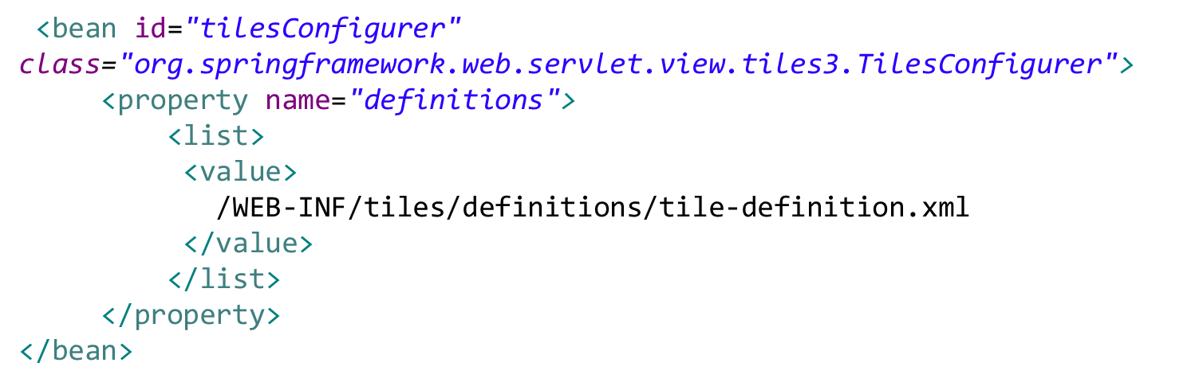
Tiles View Resolver Configuration
<bean id="tilesViewResolver"
class="org.springframework.web.servlet.view.UrlBasedViewResolver">
<property name="viewClass"
value="org.springframework.web.servlet.view.tiles3.TilesView" />
<property name="order" value="-2" />
</bean>

Slide 23
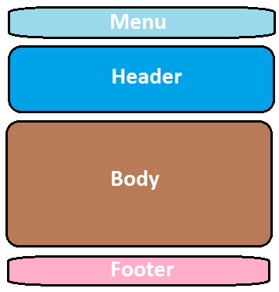
Sample Template [layoutTemplate.jsp ]
<title><tiles:insertAttribute name="title" /> <body>
<ul class="nav nav-pills pull-right">
<tiles:insertAttribute name=“menu" />
</ul>
<h3 class="text-muted">Web Store</h3>
<h1>
<tiles:insertAttribute name="header" />
</h1>
<p>
<tiles:insertAttribute name="subHeader" />
</p>
<div class="row">
<tiles:insertAttribute name=“body" />
</div>
<div class="footer">
<tiles:insertAttribute name="footer" />
</div>
</body>

Slide 24
Example Tiles Definition File
<tiles-definitions>
<definition name="baseLayout" template="/WEB-INF/layouts/template/baseLayout.jsp">
<put-attribute name="title" value="Sample Title" />
<put-attribute name="heading" value="" />
<put-attribute name="tagline" value="" />
<put-attribute name="navigation" value="/WEB-INF/layouts/template/navigation.jsp" />
<put-attribute name="content" value="" />
<put-attribute name="footer" value="/WEB-INF/layouts/template/footer.jsp" />
</definition>
</tiles-definitions>

Slide 25
Example Tiles Pages
<tiles-definitions>
<definition name="welcome" extends="baseLayout">
<put-attribute name="title" value="Products" />
<put-attribute name="heading" value="Products" />
<put-attribute name="tagline" value="All the available products in our store" />
<put-attribute name="content" value="/WEB-INF/views/products.jsp" />
</definition>
</tiles-definitions>

Slide 26
Tile Wildcards
<!-- Wild Card for all controllers...
access by /welcome for view folder JSP location
product/products for view/product folder JSP location
-->
<definition name="*/*" extends="baseLayout">
<put-attribute name="title" value="{2}.title" />
<put-attribute name="heading" value="{2}.heading" />
<put-attribute name="tagline" value="{2}.tagline" />
<put-attribute name="body" value="/WEB-INF/views/{1}/{2}.jsp" />
</definition>

Slide 27
Tiles Inline in JSP
<%@ taglib prefix="tiles" uri="http://tiles.apache.org/tags-tiles"%>
<html>
<tiles:insertDefinition name="baseLayout">
<tiles:putAttribute name="title">welcome.title</tiles:putAttribute>
<tiles:putAttribute name="heading">welcome.head</tiles:putAttribute>
<tiles:putAttribute name="tagline">welcome.tag</tiles:putAttribute>
<tiles:putAttribute name="body">
Language : <a href="?language=en_US">English</a>|
<a href="?language=zh_CN">Chinese</a>
<h3><spring:message code="welcome.spring" text="default text"/></h3>
<p> Current Locale : ${pageContext.response.locale}</p>
</tiles:putAttribute>
</tiles:insertDefinition>

Slide 28
Main Point
All websites have something in common: they are made of pages that share similar structures.
A facet of SCI is that Order is found everywhere

